Slide 1
BTECH451
Emergency SOS system
End of Year Semester
By: Wu Ye-Yue (Justin)

Slide 2
Overview
Project Objective
Where I left off last time
IPhone Application
Home Interface
Settings Interface
Algorithms Tested
Achievement
Future Work

Slide 3
Project Goal
Create mobile applications on different operation system platforms that can sense force impact collisions and provide the functions to call and send SOS messages accordingly.
Explore and Research on mobile operating systems.
Compare the results.
Working with BLACKHAWK, a GPS specialized New Zealand owned company,

Slide 4
Where I left off
Created Emergency SOS system on Android OS platform.
Talked about the algorithm used in the system.
Show the interface of that application.

Slide 5


iPhone Application
Initial icon showing on iPhone, click to open the application.
iPhone uses IOS and a combination of frameworks and SDK to create this application.
Uses tab to control between three view:
Home
Setting
Info

Slide 6
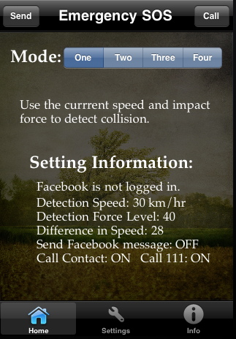
iPhone Home Interface
Initial Home Page interface
Consist of two scrolling pages
Showing the information from:
Settings
Current environment
Provide the function to choose modes

Slide 7
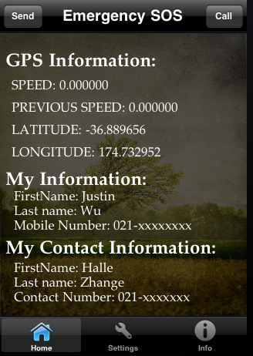
iPhone Home Interface 2
Second part of home interface consists:
GPS information containing speed, longitude, latitude and change of speed
The user and contact information that has been set up via settings.

Slide 8
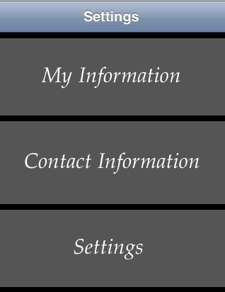
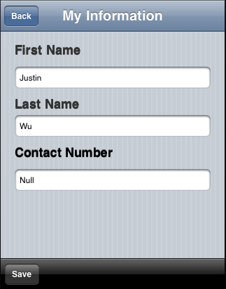
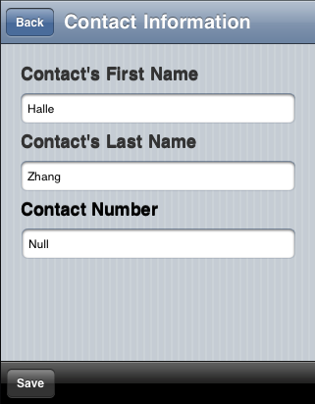
iPhone Setting Interface
The setting page interface.
The first two button goes into views where the user sets up information on the user and his or her emergency contact.

Slide 9
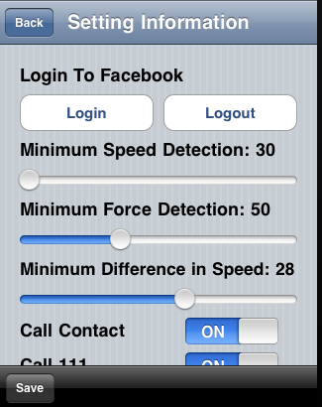

iPhone Setting Interface 2
Sets up the settings for the function of the mobile application.
Login to Facebook
Setting up detection for speed and force
Choose the function after an collision has been detected.

Slide 10

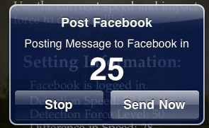
iPhone Pop up Alert
Alert Message Pop up When force collision is detected.
Contain two buttons:
Stop
Call or Send Now
The countdown pop up.

Slide 11

iPhone Functions
On the home page, user can choose four different modes to sense force impact.
Mode 1 : Senses collision by the speed of the car is currently traveling and the vibration of collision detected.
Mode 2: Use the change in speed of the car in one second time interval and the vibration to detect collision.
Mode 3: Uses the combination of the two method above to sense the collision.
Mode 4: Uses just the simple vibration from the accelerator to sense collision.

Slide 12
iPhone Functions 2
Other algorithms tried to detect collision:
Calculate force from just using the accelerometer and if the force excels a certain level, notification will be activated
Use signal towers to determine the location and speed of the car to provide extra accuracy
Combining physical equations, mass of cars, speed travel, acceleration to calculate force.

Slide 13
iPhone Functions 3
Why not use the algorithms tried in the previous slide?
Calculating force with just the accelerometer is inaccurate, due to the accelerometer’s limited distance and lack of mass. The force it detects in collision can be the same as just picking up the phone. Sensitivity.
Using signal tower to find location and speed are less accurate than just using the GPS.
With complex calculations, the influencing element is the same, therefore does not provide more accuracy to the application, instead just increase working time.

Slide 14
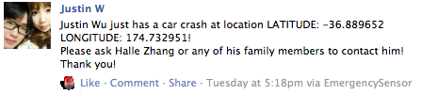
iPhone Functions 3
The Ability for user to call 111, call contact or post messages on the press of a button or when collision is detected.
Set the applications to fix your needs and the environment around you.
Interface allowing the user to cancel emergency message or calls when needed.
Provide the location of the collision side.

Slide 15
iPhone Function
Why Facebook messages used instead of SMS?
IOS prevent in app messages.
Cost effective
Using unofficial SDKs are not accepted by Apple.
Social network is view by millions simultaneously, continuously. More likelihood of discovery.
Alerting many instead of just one single person.

Slide 16
Pros, Cons and Limitations
Pros
Clear interface and easy to use.
User have the options to control the reaction of the application.
Cons
GPS is the only reliable source to calculate speed and to find location.
Constantly using GPS can drain power.
Limitations on how accurately detect collision

Slide 17
Comparison between the 2 application
Android application compared to iPhone application
Android SDK is open source, therefore providing the functions to send SMS that iPhone application are not currently allowed.
iPhone application has a more user friendly interface. Its tidiness and smooth running
Android application seems to run slower.

Slide 18
Possible Future Work
External Sensor that can be attached to people via their medical bracelets or cars to sense collision force in a more accurate manner.
More accurate measure of locations rather than just the GPS. Current limitations on the preciseness accuracy of the location.

Slide 19
Conclusion
Knowledge gained
Programming language for IOS.
Understanding of Android SDK and IOS
Gained knowledge of the differences between the two OS
Gained knowledge of how GPS and accelerator can work together.
Learn about other SDK and their functions.
Apply the concepts learnt above to write mobile programs for two different operating system.

Slide 20
Thank You
I would like to thank my supervisor for helping me through out this year and provide valuable support, advise and help
Thanks University of Auckland and Blackhawk for providing this opportunity to do this project.

Slide 21

Questions?

